Slide 1

Moving Beyond Industrial Software
patterns & practices Summit 2007
Harry Pierson
harry.pierson@microsoft.com
http://devhawk.net
Notes:
Some presentations are full of practical knowledge that you can race home after the conference and start applying. This is not one of those presentations.

Slide 2
Act 1

Slide 3
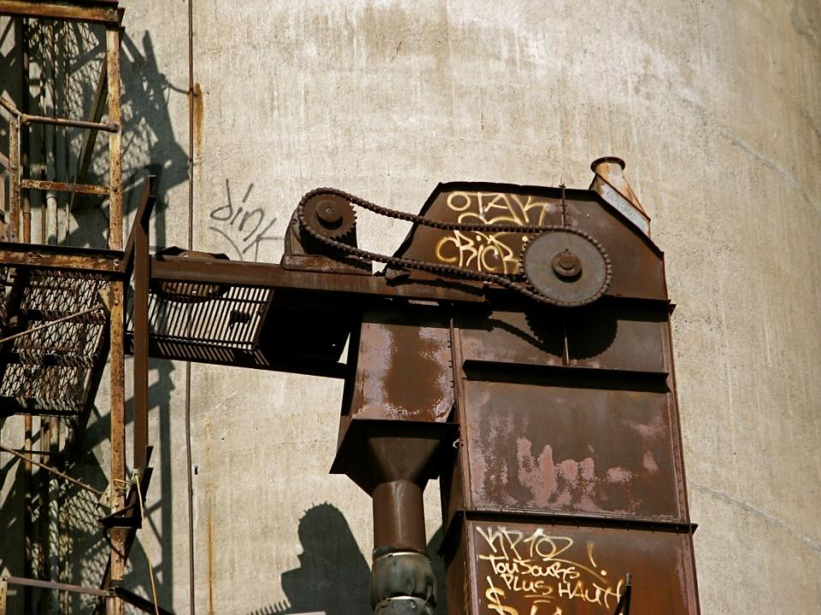
The industrial age is coming to an end.
Notes:
We are living in a time of significant upheaval. The world around us is transitioning from the industrial age to whatever comes next. Future historians will look back at this coming age and give it a proper name. Some people, like Bill Gates, call this the “information age”. Far be it for me to disagree with the Microsoft chairman – he may be retiring next year, but it’s not like he’ll be gone from the industry – but I don’t like that name very much. Information isn’t the end, it’s a means to the end. They didn’t call the previous era the factory age – factories were a means to industrialism. Information is a means to what? My guess is that information is a means to personal empowerment and so the coming age should be called the “Individual Age”. But I’m not sure, so let’s just call it post-industrial rather than trying to give it a real name. Whatever it’s called, the fact that the post-industrial age is coming implies we’re currently living in the post industrial revolution.
Image available under royalty-free license
http://www.sxc.hu/photo/885549

Slide 4

Architects like us are responsible for predicting and reacting to change.
Notes:
Now we’re all architects here. Perhaps not all architect in title, but we share a responsibility at our various organizations to build solutions that will last, hopefully for a long time. And not just technical solutions, but business solutions as well. In order to build something that lasts, you have to have some ideas about the environment the solution will last within. That almost makes architects part fortune teller, having to make educated guesses about what the future will bring.
If the industrial revolution is any indicator, the post-industrial revolution will bring dramatic change across all facets of society. Many aspects of society that we take for granted today were changes wrought by the industrial revolution. The nuclear family (mom, dad and 2 ½ kids), the nation-state, the school system, the marketplace and the corporation are all byproducts of the industrial age. Heck, even our understanding of space and time were drastically altered by the industrial revolution. In the agricultural age, there was no need for precision when it came to space or time. Towns were “a days walk” or “two days on horseback” away. We used the size of our feet to measure things.
The post-industrial age will likely bring fundamental changes to how we perceive the world. As architects, our responsibility is to recognize those changes as early as possible because change represents opportunity.
Image licensed under Creative Commons Attribution-No Derivative Works 2.0 Generic
http://www.flickr.com/photos/vintagehalloweencollector/1450979990/

Slide 5

Most IT departments are run like a factory.
Notes:
What’s the difference between a cubicle farm and an assembly line. Not enough.
Summarize the industrial tenets (Standardization, Specialization, Synchronization, Concentration, Maximization, Centralization). Use school system as example of industrial tenets (Schools teach punctuality & obedience).
Since the corporation was born from the industrial age, it should be no surprise that it is run like a factory. Adhering to these tenets was needed in the industrial age.
Image available under royalty-free license
http://www.sxc.hu/photo/455596

Slide 6

A changing world demands a new approach.
Notes:
Discuss how the tenets of the industrial age have become liabilities in the post industrial age
An industrial approach is rapidly becoming obsolete.
Describe what is happening in the media word – ‘newspaper readership, network tv viewing, radio listeners, movie goers are all shrinking. As one can be published, do a radio show or make a movie.
Image available under royalty-free license
http://office.microsoft.com/clipart/preview.aspx?AssetID=MPj0387759

Slide 7

The time has come to move beyond industrial software.
Notes:
I realize that to much of what I’m suggesting here sounds like a recipe for chaos. Compared to the rigorous control afforded by an industrial factory approach, I guess it could be characterized as “barely controlled chaos.” A society focused on personal empowerment is obviously going to be much more chaotic that a society focused on industrialism.
You can roll with the changes, or you can fight them. Personally, I believe natural selection will take care of companies that don’t adapt.
Image licensed under Creative Commons Attribution 2.0 Generic
http://www.flickr.com/photos/grdloizaga/538604977/

Slide 8
Act 2

Slide 9
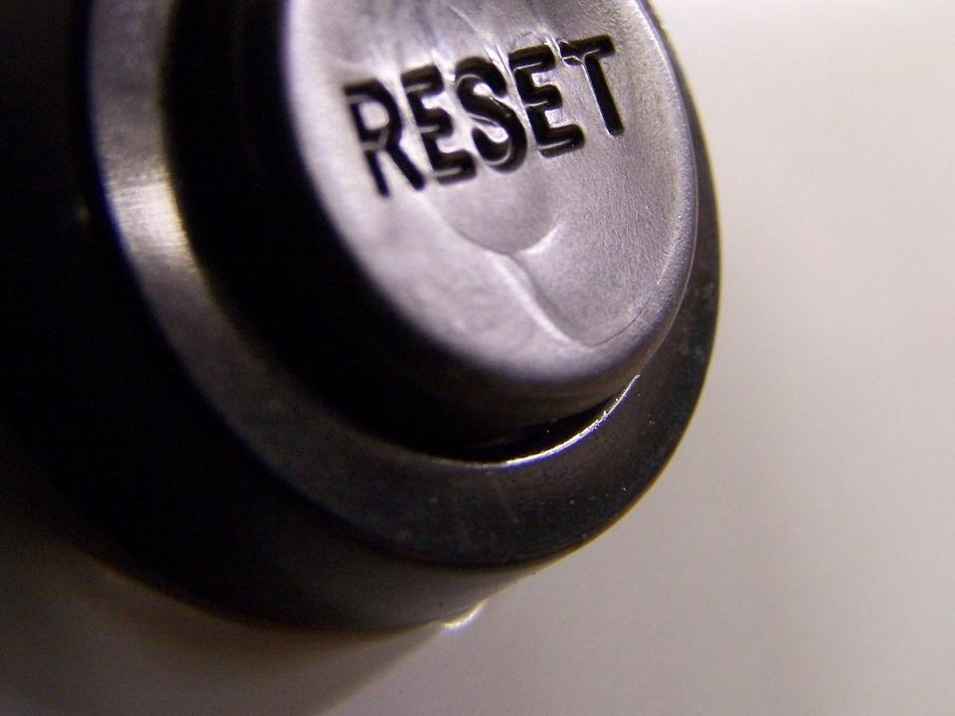
Push control to the edge.
Notes:
Discuss the benefits of decentralization. Decentralization of information has been a core software value from the start of the PC era. Bring the information out to the people who need to make the decision rather than bringing the decision in to the people who had the information. There’s to much information now for a single person or
Image licensed under Creative Commons Attribution 2.0 Generic
http://www.flickr.com/photos/flattop341/224175619/

Slide 10
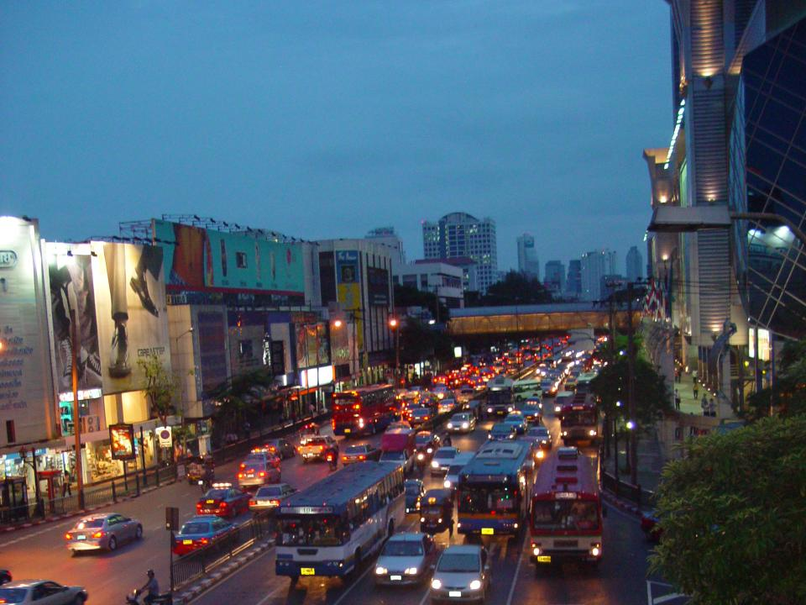
The center is a bottleneck.
Notes:
Discuss the central service repository
Discuss the diminishing role of central EA.
Image available under royalty-free license
http://www.sxc.hu/photo/801668

Slide 11

Move fast and be agile.
Notes:
The world used to move in sync with the factory, now it moves at the speed of light. It seems like there’s at least one new hot Web 2.0 company every week. You may think they’re in a different sector that the more traditional enterprise, and to many extents they are. For now. But so-called traditional enterprises should be wary of those web 2.0 companies as they become disruptive innovations.
Discuss innovators dilemma & disruptive innovation. “My website is bigger than your enterprise”
Industrial techniques are too slow and non-agile to be successful in the post-industrial world.
Image licensed under Creative Commons Attribution 2.0 Generic
http://www.flickr.com/photos/48745248@N00/137162212/

Slide 12
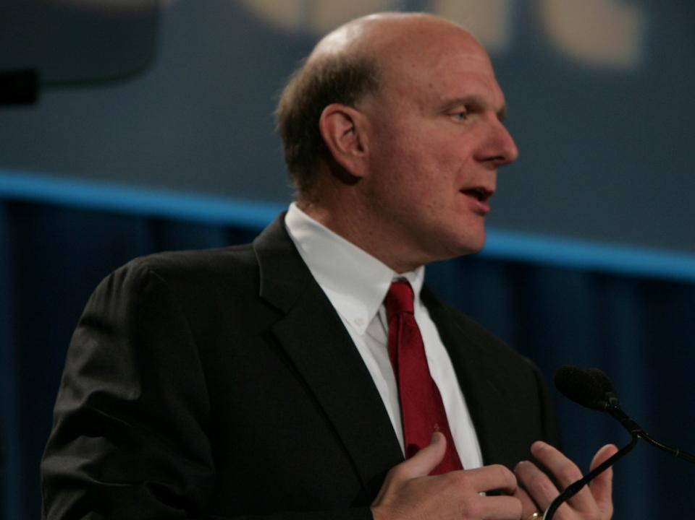
“There’s not one Microsoft anymore.”
Notes:
This is a quote from Steve Balmer at the most recent Microsoft internal company meeting. He graciously gave me permission to use this quote in this presentation. Let me read you the full quote:
“We’re going to be, really, many Microsofts, big and small. Small teams. Big teams, Individual teams. Teams that have something to do with one another. Teams that are really independent. We’re going to be based upon the commitment and strength and power of each and every person in this room. There’s not one Microsoft anymore. We share some things, but we have a bunch of little Microsoft’s inside of us.
Yes, there is a Microsoft way. You heard about it from Bill, you heard about it from Ray and you’ll hear about it from me. We’re going to talk to you a little bit about the way of Microsoft. But there’s the way of EDD, there’s the way of MED. Shared, but at the same time, small teams accomplishing great things with amazing individuals behind them.”
Here we have the CEO of a Fortune 50 company, a company that arguably has had some of the greatest influence on the post-industrial revolution, bluntly stating that his company is and will be more decentralized over time. Thanks for making my point, Steve.
Image available from Microsoft PressPass

Slide 13

Know when to ignore standards.
Notes:
Talk about standardization in history. Post-industrial approaches build personalized experienced on top of standardized infrastrucuture.
Standardization is another industrial tenet that’s fading in importance. Standards are critical for basic connectivity. Roads, telephones, electricity, TCP/IP. But we’re not building systems just so we can implement standards. We’re trying to solve business problems. Given a choice between adhering to the standard vs. solving the problem, you should always choose to solve the problem
Image available under royalty-free license
http://www.sxc.hu/photo/760920

Slide 14

The cost to maintain standards isn’t zero.
Notes:
Discuss Microsoft expense receipt policy. They don’t bother to “watch every penny”.
The primary thing the central EA group churns out is standards. What to use and how to use it. They spend a lot of effort determining how much it costs to not be standardized. But they rarely in my experience determine the cost of becoming and staying standardized.
Zappos.com places shoes randomly on the shelves of their warehouse. Location is tracked by computer. “Zappos experimented with various taxonomies and organizational systems, but none of them scaled. New shoes came in and old shoes went out, seasons changed and so did styles. When a vendor creates a new line, you can't just shift everything down to make room for it next to the old line. When a line is discontinued there's no way to pull everything up to fill in the space. Short of reorganizing the entire warehouse with every twitch of the marketplace, no ordered system was better than any other at accommodating change. “
Chris Anderson, author of The Long Tail
http://www.longtail.com/the_long_tail/2007/01/everything_is_m.html
Image licensed under Creative Commons Attribution 2.0 Generic
http://www.flickr.com/photos/jswieringa/119137124/

Slide 15

Harness natural innovation.
Notes:
Discuss how standardization stifles creativity.
Discuss how different tools have different strengths and weaknesses.
Trust the teams to do the right thing
Image available under royalty-free license
http://www.sxc.hu/photo/786044

Slide 16
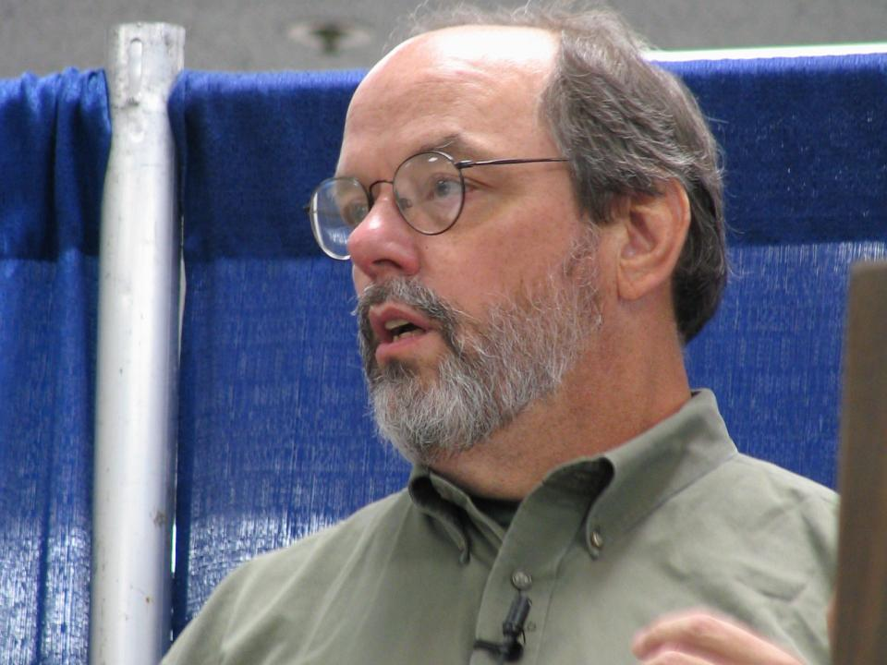
“What's the simplest thing that could possibly work?”
Notes:
Ward Cunningham Quote from http://c2.com/ppr/wiki/ExtremeProgrammingRoadmap/DoTheSimplestThingThatCouldPossiblyWork.html
You can’t do away with all standards. But don’t over-emphases them. You can cut them back to the bare minimum. Standards work when they’re simple
Image licensed under Creative Commons Attribution-No Derivative Works 2.0 Generic
http://www.flickr.com/photos/peterkaminski/57022607/

Slide 17

Empower users to solve problems.
Notes:
Discuss prosumtion – aka producing for ones own consumption.
Image available under royalty-free license
http://office.microsoft.com/clipart/preview.aspx?AssetID=MPj0400348

Slide 18

IT people will never understand the business.
Notes:
Discuss the lack of marketplace within the enterprise
Image available under royalty-free license
http://office.microsoft.com/clipart/preview.aspx?AssetID=MPj0422224

Slide 19
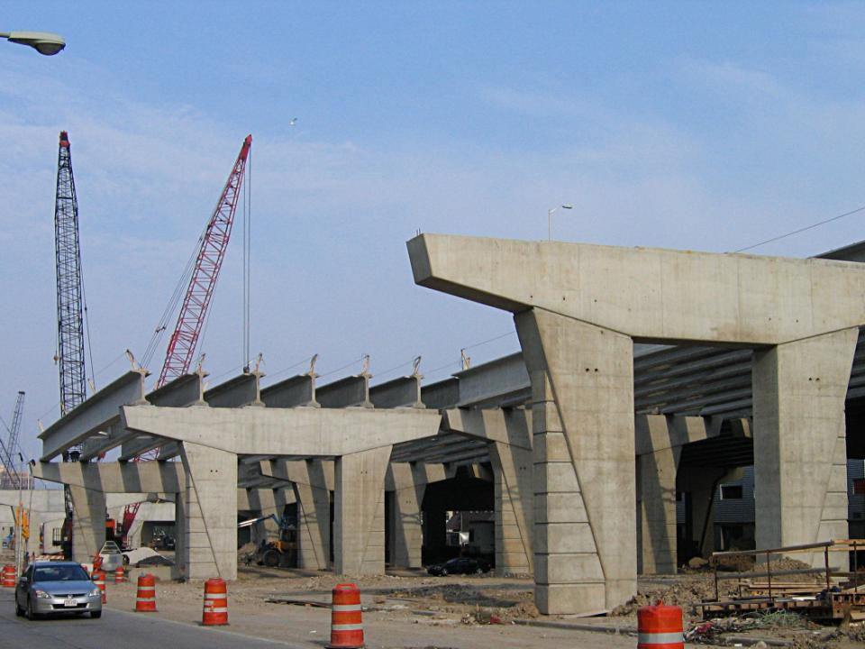
Build infrastructure and tools, not solutions
Notes:
Scott Ambler talked about this keynote this morning a little bit. But I’m going beyond what Scott said. Scott wants the SME’s involved. I want the SME to do the work.
Discuss the Sharepoint model.
Image licensed under Creative Commons Attribution 2.0 Generic
http://www.flickr.com/photos/beigephotos/511606857/

Slide 20
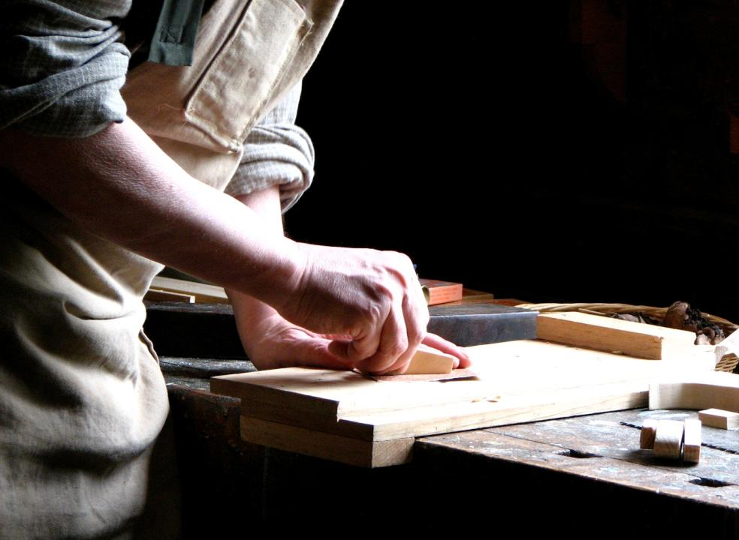
“If you want something done right, do it yourself.”
Notes:
Of course, right here is subjective. Right for IT and right for the business probably don’t look the same. But right for IT should always take a backseat to right for the business.
The IT department should live by Home Depot’s motto. “You can do it, we can help”
Image available under royalty-free license
http://www.sxc.hu/photo/824010

Slide 21
Act 3

Slide 22

Can you accept a new mental model?
Notes:
Discuss the conflict between traditional architecture approach and Scott Ambler’s agile approach.
“We’re seeing these two approaches to enterprise architecture and software construction. You could call it waterfall vs. agile. Personally, I see it as industrial vs. post-industrial. One the waterfall side, we have the “traditional” approaches driven directly out of industrial thinking. Deep hierarchies, layers of bureaucracy – bureaucrat is another artifact of the industrial age – , massive centralization of knowledge, etc. On the other side, you have the agile approach rejecting the basic assumptions of how things should be deisgned and literally revolting against traditional approaches.
If you accept that we are living thru the post industrial revolution, then you should be immediately suspicious of anything that subscribes to the industrial tenets.
Tell “more centralized” MIO story
Image available under royalty-free license
http://www.sxc.hu/photo/880737

Slide 23

“Factory” is a poor model for the IT department.
Notes:
Image licensed under Creative Commons Attribution 2.0 Generic
http://www.flickr.com/photos/abulic_monkey/130899453/

Slide 24

New models are slowly emerging.
Notes:
The new models are only half baked. There’s lots of unanswered questions. When you get up and present a keynote, you don’t focus on them, but that doesn’t mean they’re still there. There’s a tendency to reject a given approach because it isn’t fleshed out 100%. That’s industrial thinking.
Image available under royalty-free license
http://www.sxc.hu/photo/468557

Slide 25

“In times of profound change, the learners inherit the earth, while the learned find themselves beautifully equipped to deal with a world that no longer exists.”
Notes:
This quote is from social psychologist Eric Hoffer from his 1973 book Reflections on the Human Condition.
Image licensed under Creative Commons Attribution 2.0 Generic
http://www.flickr.com/photos/minette_layne/1486584191

Slide 26

Learn to ride the post-industrial wave.
Notes:
Image available under royalty-free license
http://office.microsoft.com/clipart/preview.aspx?AssetID=MPj0423052

